Slide 1
Library Management System (DBA 120 Final Project)
Using Python + MySQL (Raw SQL, Console UI)

Slide 2
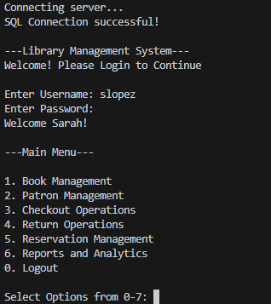
System Overview / Menu Screenshot
Starts in by connecting to the SQL Server linked with Python’s extension (mysql.connector)
Staff Login Authentication
Main Menu (Includes Book, Patron, and Reservation Management using CRUD)
Checkout and Return Operations (For renters)
Special Queries for Reports & Analytics
All of the pages were loaded with functions in Python
(Uses StaffID as a parameter and argument)

Slide 3
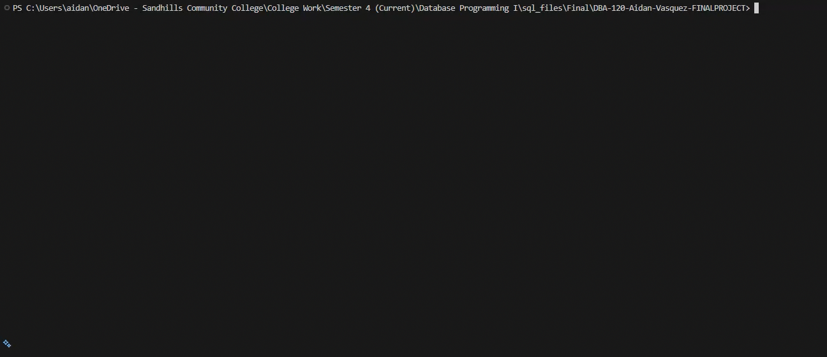
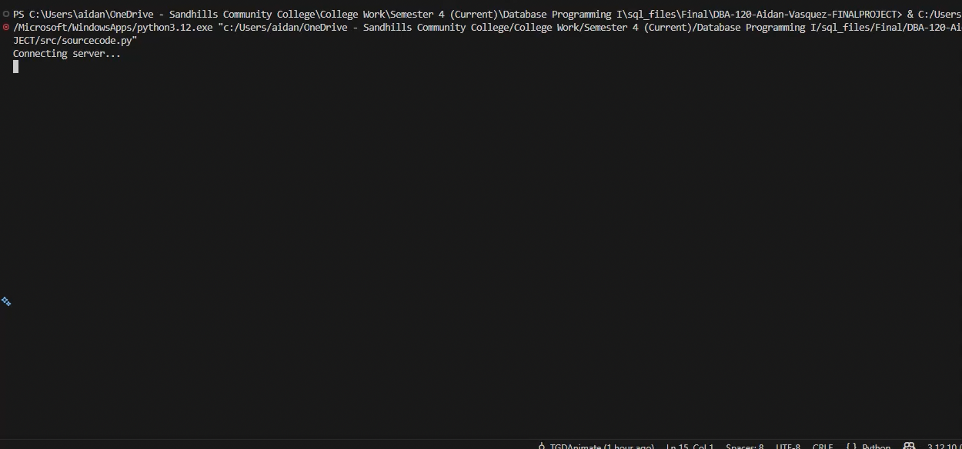
Demos
Video 1: Checkout a Book
Video 2: Return a Book

Slide 4
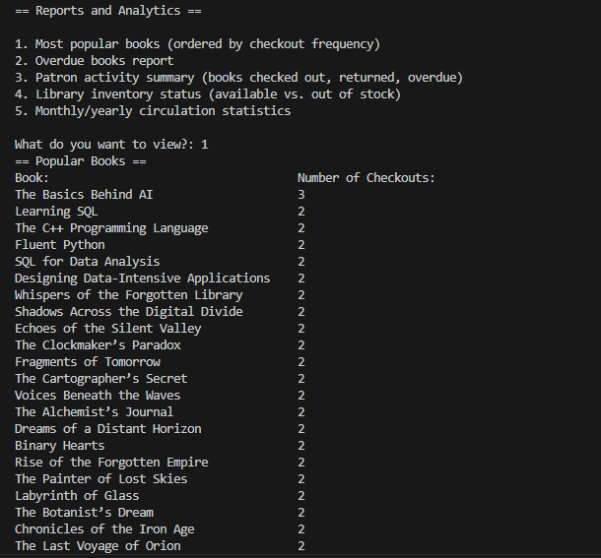
Reporting & Analytics
SQL JOINs across multiple tables
Aggregate functions (COUNT, SUM)
Date-based filtering (overdue logic)
Inventory calculations (available vs checked out)
Monthly & yearly circulation trends

